Slide 1
Mathematical Methods for Scientific Computing
Matrices
Stephen Millmore
Laboratory for Scientific Computing,
University of Cambridge

Slide 2
Outline
1. Properties of matrices
2. Elementary operations
3. The inverse
4. The determinant
5. Eigenvalues and eigenvectors
6. LU decomposition

Slide 3
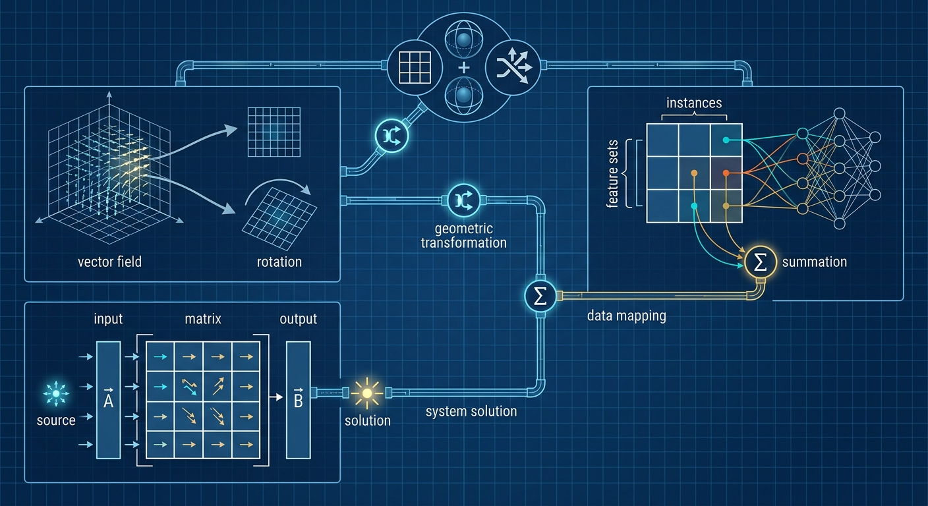
Properties of matrices

Slide 4
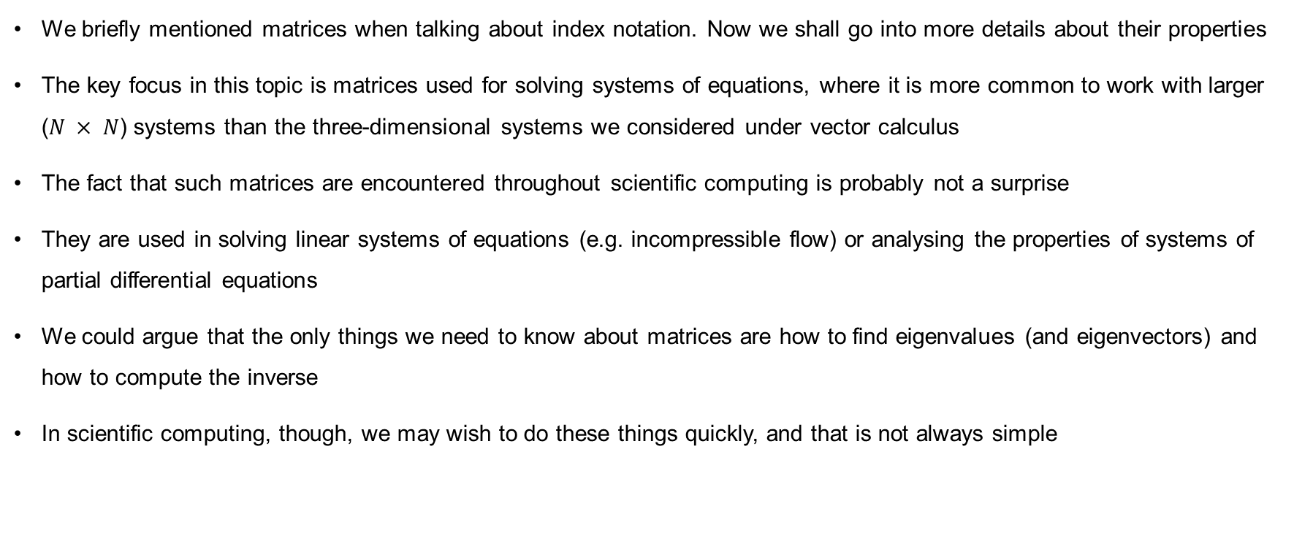
Matrices
We briefly mentioned matrices when talking about index notation. Now we shall go into more details about their properties
The key focus in this topic is matrices used for solving systems of equations, where it is more common to work with larger ($N × N$) systems than the three-dimensional systems we considered under vector calculus
The fact that such matrices are encountered throughout scientific computing is probably not a surprise
They are used in solving linear systems of equations (e.g. incompressible flow) or analysing the properties of systems of partial differential equations
We could argue that the only things we need to know about matrices are how to find eigenvalues (and eigenvectors) and how to compute the inverse
In scientific computing, though, we may wish to do these things quickly, and that is not always simple

Slide 5

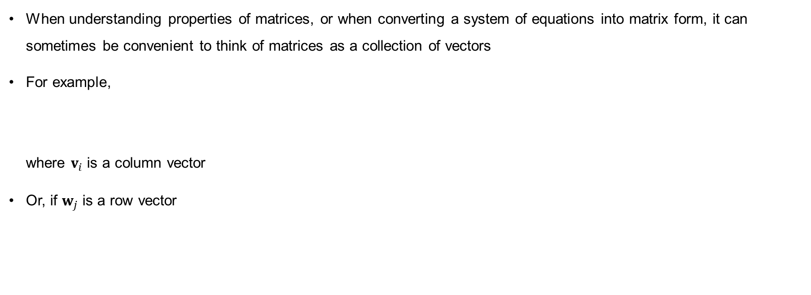
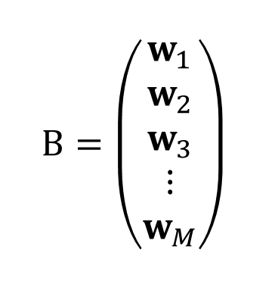
Matrices and vectors
When understanding properties of matrices, or when converting a system of equations into matrix form, it can sometimes be convenient to think of matrices as a collection of vectors
For example,
where $v_{i}$ is a column vector
Or, if $w_{j}$ is a row vector
$$A=\left(v_{1}|v_{2}|v_{3}|⋯|v_{M}\right)$$
Note – this is not true index notation here, since the vector remains a vector
$$B=\left(\begin{matrix}w_{1} \\ w_{2} \\ w_{3} \\ ⋮ \\ w_{M}\end{matrix}\right)$$

Slide 6
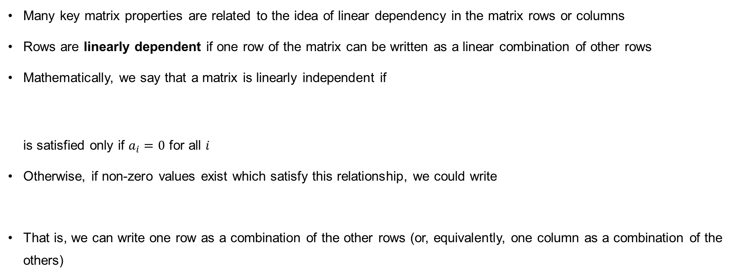

Linear dependency
Many key matrix properties are related to the idea of linear dependency in the matrix rows or columns
Rows are linearly dependent if one row of the matrix can be written as a linear combination of other rows
Mathematically, we say that a matrix is linearly independent if
is satisfied only if $a_{i}=0$ for all $i$
Otherwise, if non-zero values exist which satisfy this relationship, we could write
That is, we can write one row as a combination of the other rows (or, equivalently, one column as a combination of the others)
$$a_{1}v_{1}+a_{2}v_{2}+a_{3}v_{3}+⋯+a_{M}v_{M}=0$$
$$v_{1}=\frac{1}{a_{1}}\left(a_{2}v_{2}+a_{3}v_{3}+⋯+a_{M}v_{M}\right)$$

Slide 7


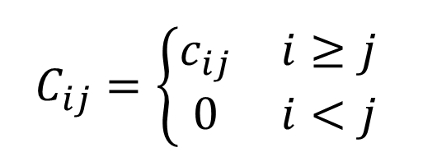
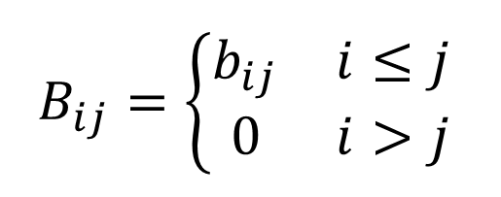

Familiar types of matrix
Most of these properties require that the matrix is square – this is the most common type found in scientific computing
Symmetric matrices
Antisymmetric matrices
Diagonal matrices
Upper triangular matrices
Lower triangular matrices
$$A_{ij}=A_{ji}$$
$$B_{ij}=\left\{\begin{matrix}b_{ij} & i≤j \\ 0 & i>j\end{matrix}\right.$$
$$A_{ij}=−A_{ji}$$
$$C_{ij}=\left\{\begin{matrix}c_{ij} & i≥j \\ 0 & i<j\end{matrix}\right.$$
$$A_{ij}=0 if i≠j$$

Slide 8

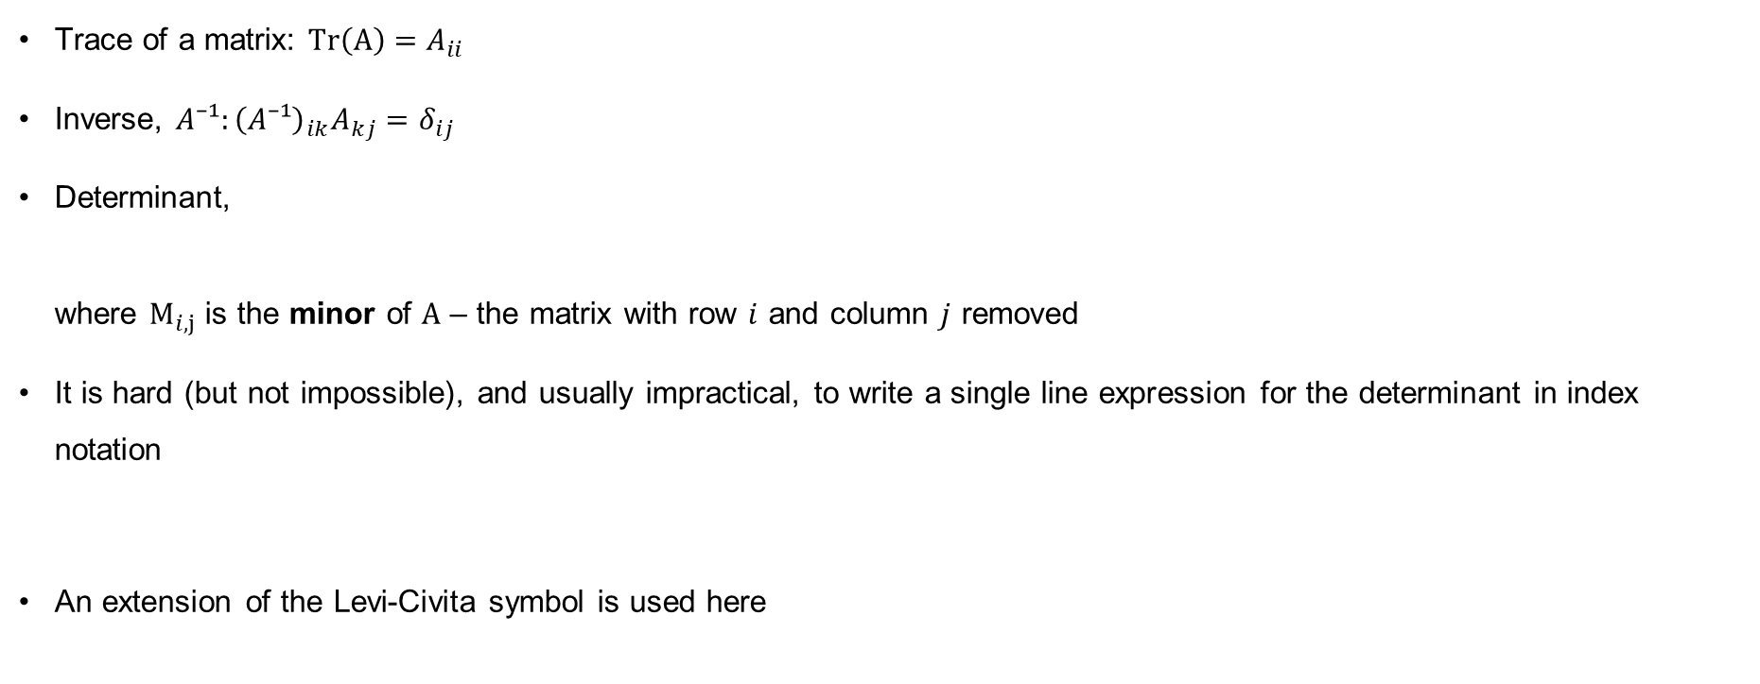
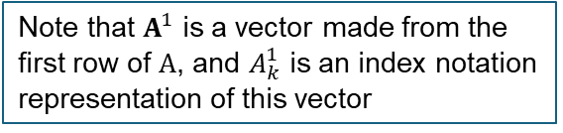
Familiar square matrix properties
Note that $A^{1}$ is a vector made from the first row of $A$, and $A_{k}^{1}$ is an index notation representation of this vector
Trace of a matrix: $Tr\left(A\right)=A_{ii}$
Inverse, $A⁻¹:{\left(A⁻¹\right)}_{ik}A_{kj}=δ_{ij}$
Determinant,
where $M_{i,j}$ is the minor of $A$ – the matrix with row $i$ and column $j$ removed
It is hard (but not impossible), and usually impractical, to write a single line expression for the determinant in index notation
An extension of the Levi-Civita symbol is used here
$$det⁡(A)=\sum_{k}{(−1)^{1+k}M_{1,k}A_{k}^{1}}$$
$$det⁡(A)=ε_{i_{1}i_{2}i_{3}…i_{N}}A_{i_{1}}^{1}A_{i_{2}}^{2}A_{i_{3}}^{3}…A_{i_{N}}^{N}$$

Slide 9
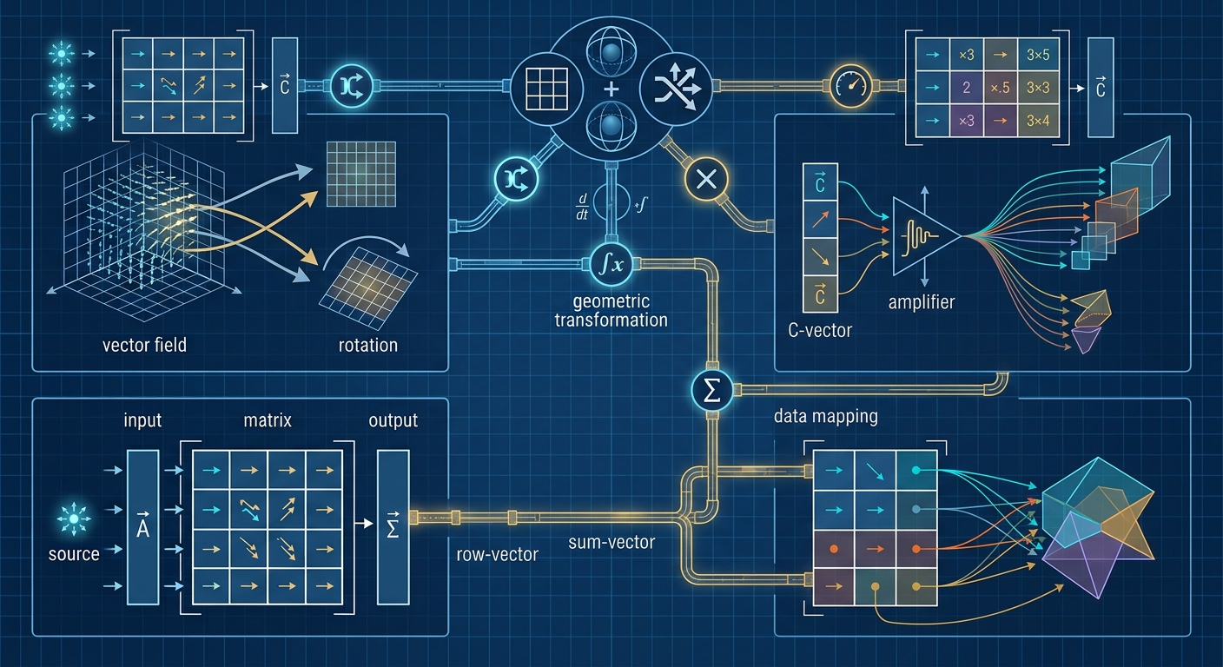
Elementary operations

Slide 10
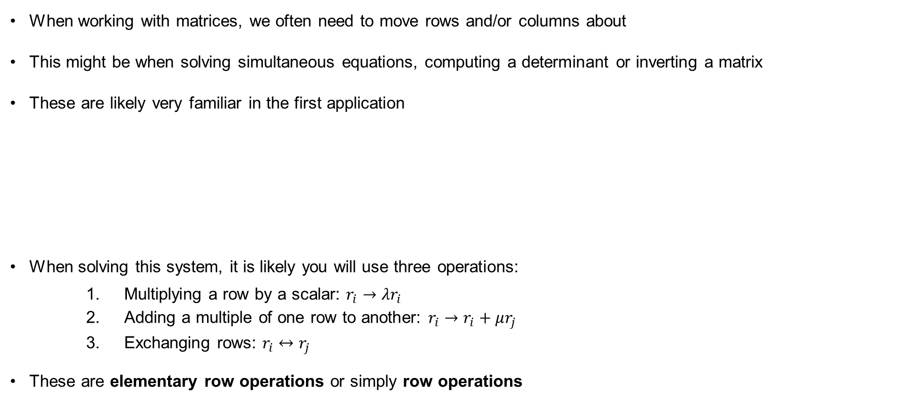
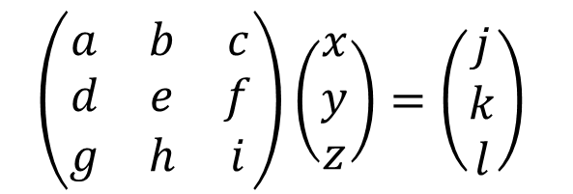
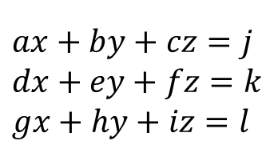
Elementary row and column operations
When working with matrices, we often need to move rows and/or columns about
This might be when solving simultaneous equations, computing a determinant or inverting a matrix
These are likely very familiar in the first application
When solving this system, it is likely you will use three operations:
    Multiplying a row by a scalar: $r_{i}→λr_{i}$
    Adding a multiple of one row to another: $r_{i}→r_{i}+μr_{j}$
    Exchanging rows: $r_{i}↔r_{j}$
These are elementary row operations or simply row operations
$$ax+by+cz=j$$
$$dx+ey+fz=k$$
$$gx+hy+iz=l$$
$$\left(\begin{matrix}a & b & c \\ d & e & f \\ g & h & i\end{matrix}\right)\left(\begin{matrix}x \\ y \\ z\end{matrix}\right)=\left(\begin{matrix}j \\ k \\ l\end{matrix}\right)$$

Slide 11
Row operations

Slide 12
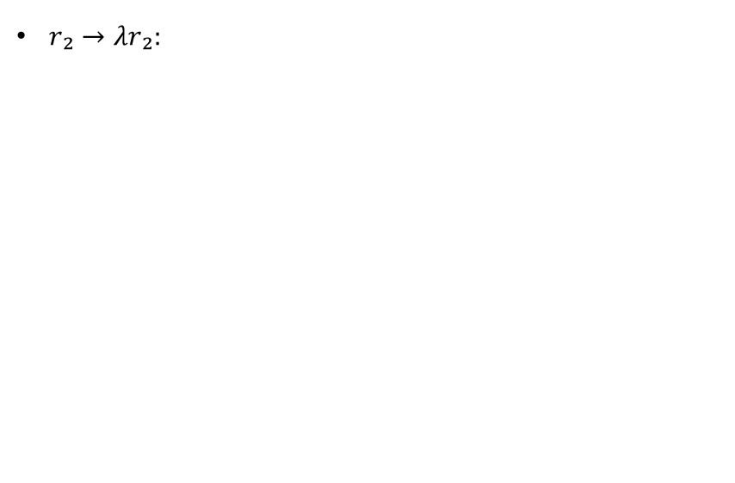
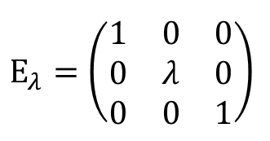
Elementary row (column) operation matrices
Each of the elementary row (or column) operations can be considered as a matrix which multiplies our initial matrix, or equation, from the left (or right, for column operations)
$r₂→λr₂:$
$$E_{λ}=\left(\begin{matrix}1 & 0 & 0 \\ 0 & λ & 0 \\ 0 & 0 & 1\end{matrix}\right)$$

Slide 13
Row operations

Slide 14
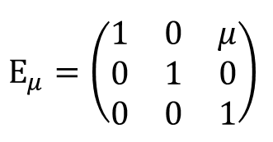
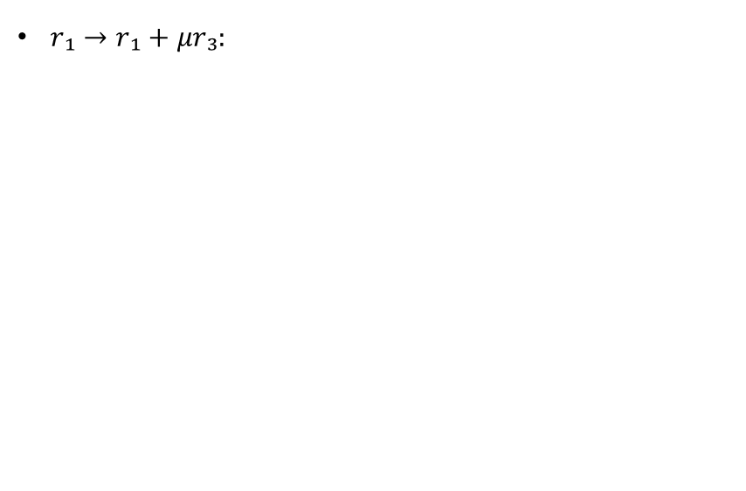
Elementary row (column) operation matrices
Each of the elementary row (or column) operations can be considered as a matrix which multiplies our initial matrix, or equation, from the left (or right, for column operations)
$r₂→λr₂:$
$r₁→r₁+μr₃:$
$$E_{λ}=\left(\begin{matrix}1 & 0 & 0 \\ 0 & λ & 0 \\ 0 & 0 & 1\end{matrix}\right)$$
$$E_{μ}=\left(\begin{matrix}1 & 0 & μ \\ 0 & 1 & 0 \\ 0 & 0 & 1\end{matrix}\right)$$

Slide 15
Row operations

Slide 16
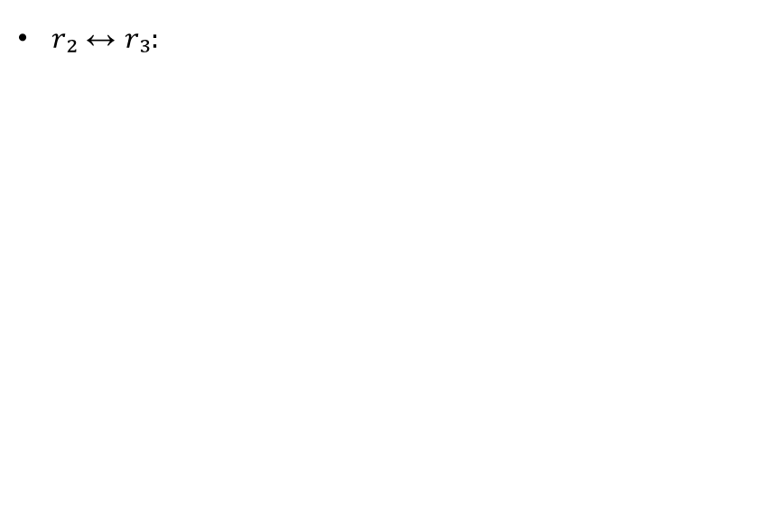
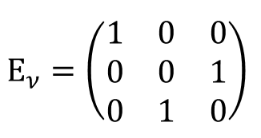
Elementary row (column) operation matrices
Each of the elementary row (or column) operations can be considered as a matrix which multiplies our initial matrix, or equation, from the left (or right, for column operations)
$r₂→λr₂:$
$r₁→r₁+μr₃:$
$r₂↔r₃:$
$$E_{λ}=\left(\begin{matrix}1 & 0 & 0 \\ 0 & λ & 0 \\ 0 & 0 & 1\end{matrix}\right)$$
$$E_{μ}=\left(\begin{matrix}1 & 0 & μ \\ 0 & 1 & 0 \\ 0 & 0 & 1\end{matrix}\right)$$
$$E_{ν}=\left(\begin{matrix}1 & 0 & 0 \\ 0 & 0 & 1 \\ 0 & 1 & 0\end{matrix}\right)$$

Slide 17
Row operations

Slide 18
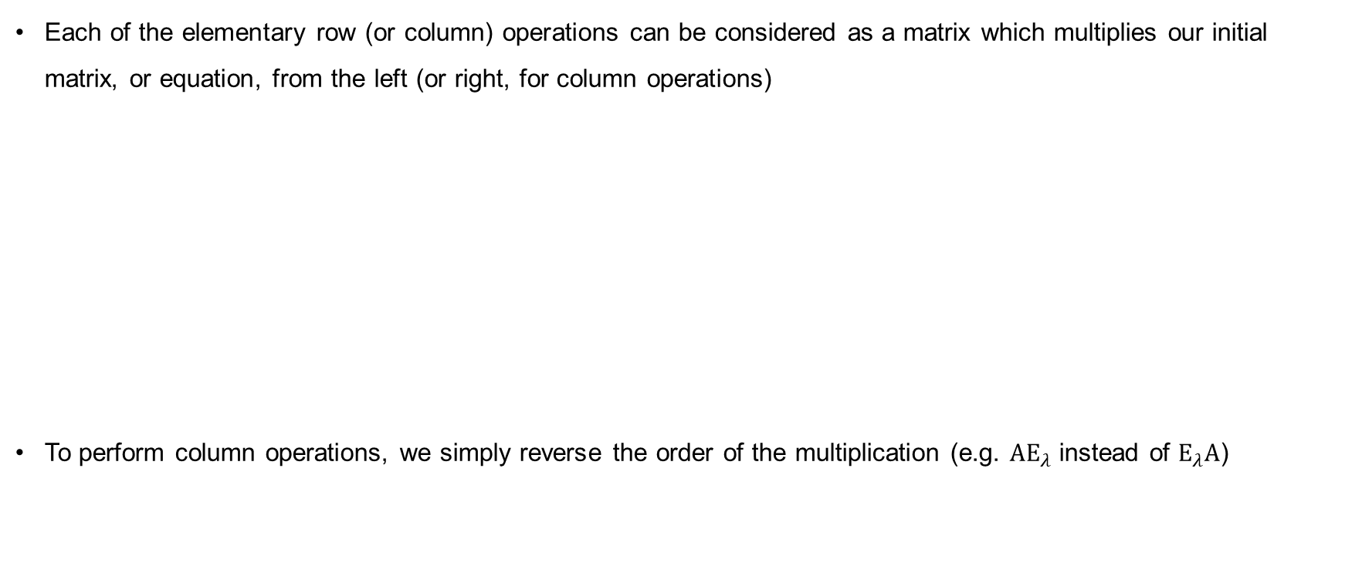
Elementary row (column) operation matrices
Each of the elementary row (or column) operations can be considered as a matrix which multiplies our initial matrix, or equation, from the left (or right, for column operations)
To perform column operations, we simply reverse the order of the multiplication (e.g. $AE_{λ}$ instead of $E_{λ}A$)
$r₂→λr₂:$
$r₁→r₁+μr₃:$
$r₂↔r₃:$
$$E_{λ}=\left(\begin{matrix}1 & 0 & 0 \\ 0 & λ & 0 \\ 0 & 0 & 1\end{matrix}\right)$$
$$E_{μ}=\left(\begin{matrix}1 & 0 & μ \\ 0 & 1 & 0 \\ 0 & 0 & 1\end{matrix}\right)$$
$$E_{ν}=\left(\begin{matrix}1 & 0 & 0 \\ 0 & 0 & 1 \\ 0 & 1 & 0\end{matrix}\right)$$

Slide 19
Column operations

Slide 20
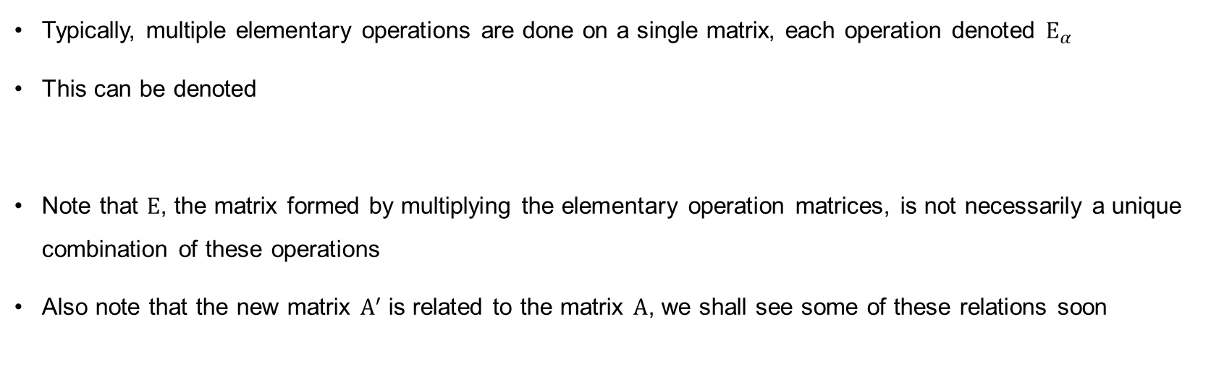
Elementary matrix notation
Typically, multiple elementary operations are done on a single matrix, each operation denoted $E_{α}$
This can be denoted
Note that $E$, the matrix formed by multiplying the elementary operation matrices, is not necessarily a unique combination of these operations
Also note that the new matrix $A^{′}$ is related to the matrix $A$, we shall see some of these relations soon
$$A^{′}=E_{n}E_{n−1}…E_{2}E_{1}A=EA$$

Slide 21
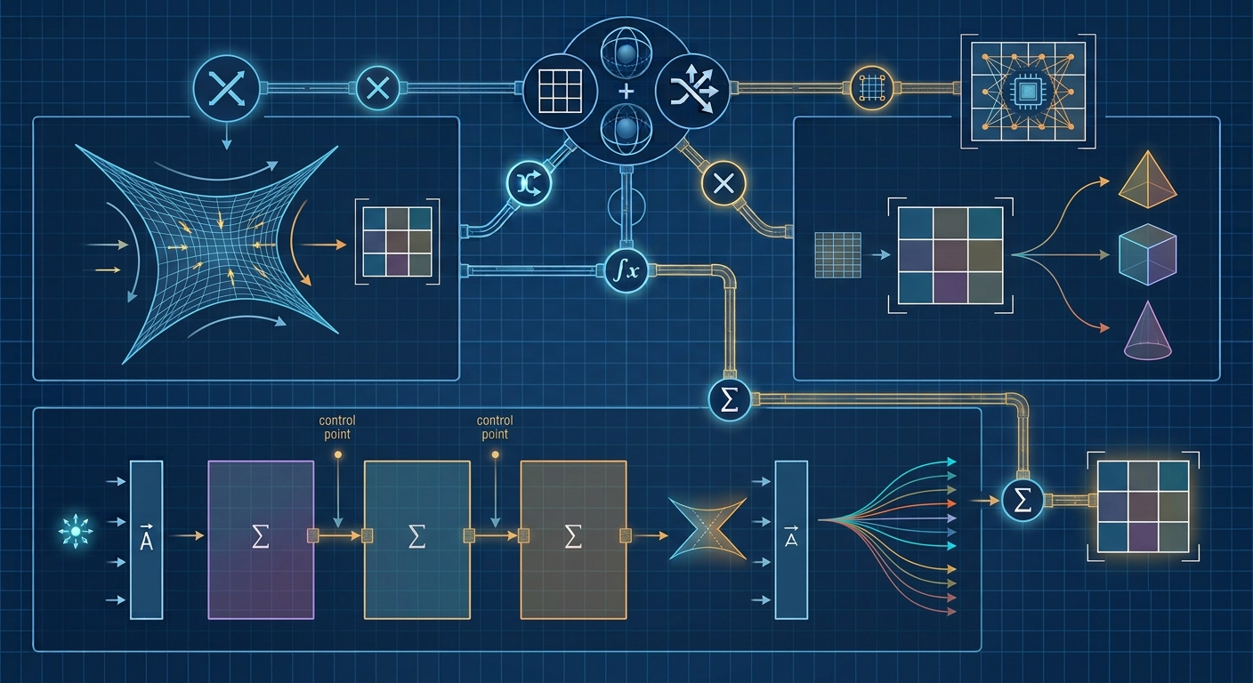
The inverse

Slide 22
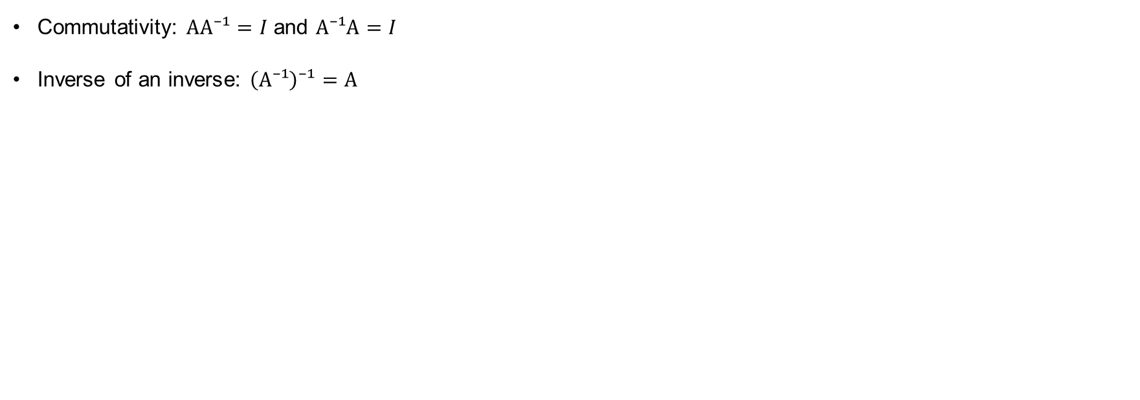
Properties of the inverse
Commutativity: $AA⁻¹=I$ and $A⁻¹A=I$
Inverse of an inverse: $\left(A⁻¹\right)⁻¹=A$

Slide 23
Inverse of an inverse

Slide 24
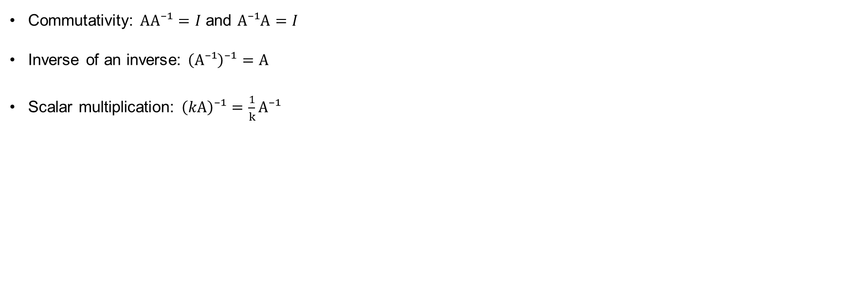
Properties of the inverse
Commutativity: $AA⁻¹=I$ and $A⁻¹A=I$
Inverse of an inverse: $\left(A⁻¹\right)⁻¹=A$
Scalar multiplication: $\left(kA\right)⁻¹=\frac{1}{k}A⁻¹$

Slide 25
Scalar multiplication

Slide 26
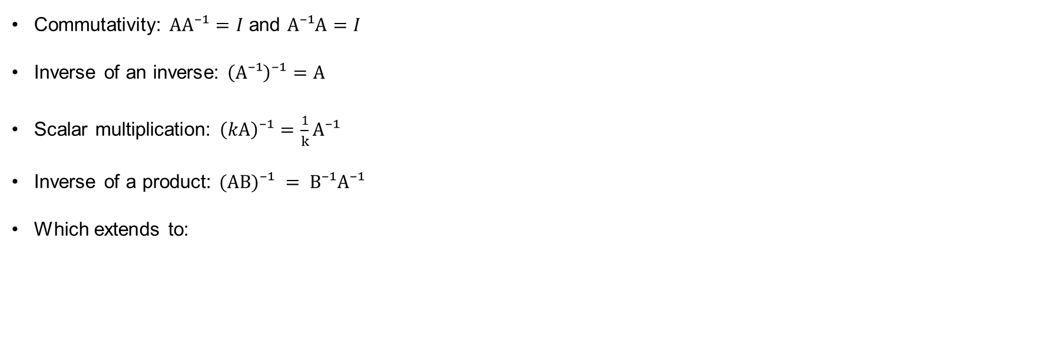
Properties of the inverse
Commutativity: $AA⁻¹=I$ and $A⁻¹A=I$
Inverse of an inverse: $\left(A⁻¹\right)⁻¹=A$
Scalar multiplication: $\left(kA\right)⁻¹=\frac{1}{k}A⁻¹$
Inverse of a product: $(AB)⁻¹ = B⁻¹A⁻¹$
Which extends to:
$$(A_{1}A_{2}…A_{n})^{−1}=(A_{n})^{−1}…(A_{2})^{−1}(A_{1})^{−1}$$

Slide 27
Inverse of a product

Slide 28
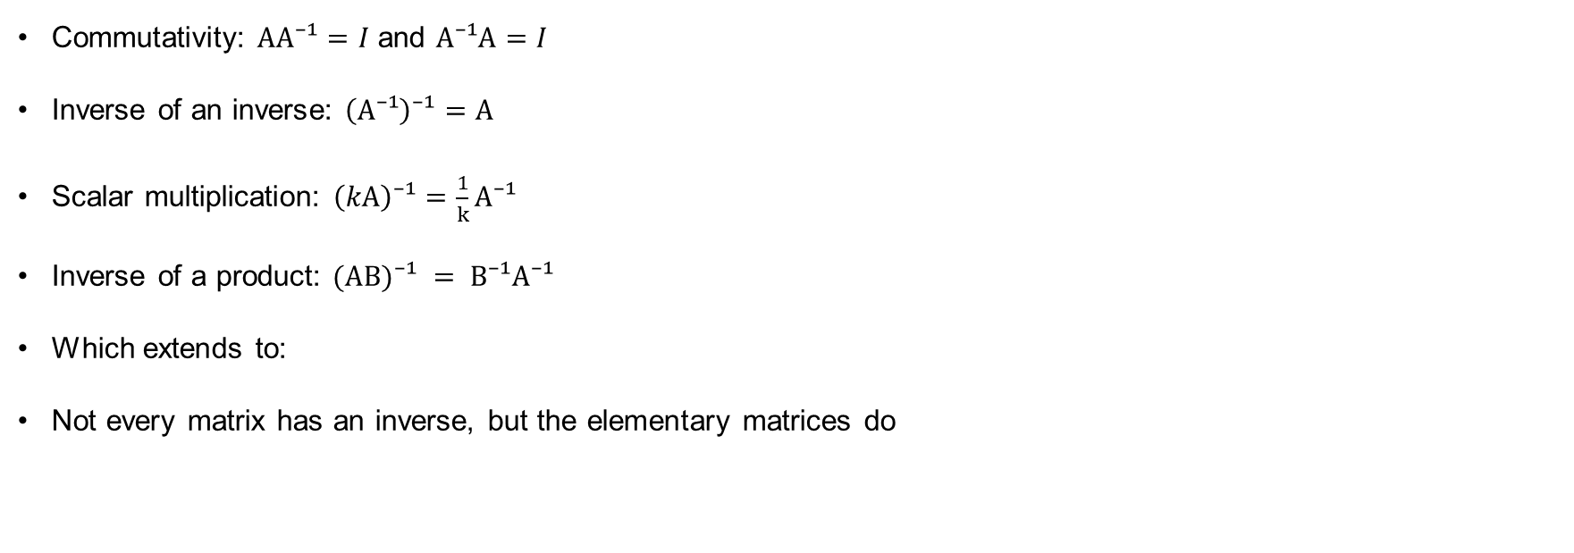
Properties of the inverse
Commutativity: $AA⁻¹=I$ and $A⁻¹A=I$
Inverse of an inverse: $\left(A⁻¹\right)⁻¹=A$
Scalar multiplication: $\left(kA\right)⁻¹=\frac{1}{k}A⁻¹$
Inverse of a product: $(AB)⁻¹ = B⁻¹A⁻¹$
Which extends to:
Not every matrix has an inverse, but the elementary matrices do
$$(A_{1}A_{2}…A_{n})^{−1}=(A_{n})^{−1}…(A_{2})^{−1}(A_{1})^{−1}$$

Slide 29

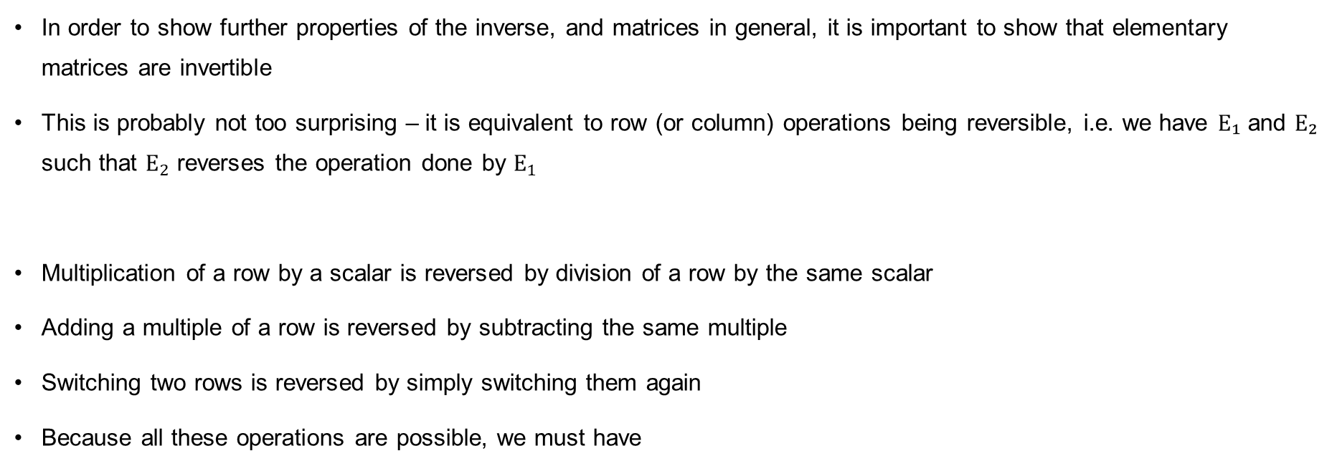
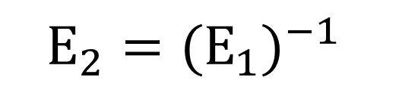
Inverse of the elementary matrices
In order to show further properties of the inverse, and matrices in general, it is important to show that elementary matrices are invertible
This is probably not too surprising – it is equivalent to row (or column) operations being reversible, i.e. we have $E₁$ and $E₂$ such that $E_{2}$ reverses the operation done by $E_{1}$
Multiplication of a row by a scalar is reversed by division of a row by the same scalar
Adding a multiple of a row is reversed by subtracting the same multiple
Switching two rows is reversed by simply switching them again
Because all these operations are possible, we must have
$$E_{2}E_{1}A=A$$
$$E_{2}=(E_{1})^{−1}$$

Slide 30
Inverse of elementary matrices

Slide 31

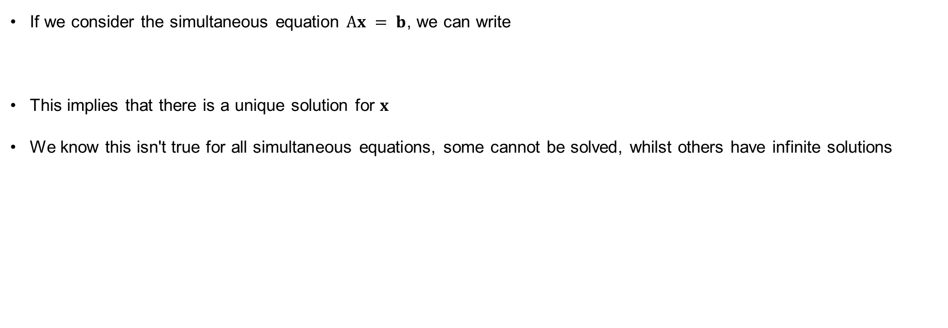
Non-invertible matrices
If we consider the simultaneous equation $Ax = b$, we can write
This implies that there is a unique solution for $x$
We know this isn't true for all simultaneous equations, some cannot be solved, whilst others have infinite solutions
$$A^{−1}Ax=x=A^{−1}b$$

Slide 32
Underdetermined system

Slide 33
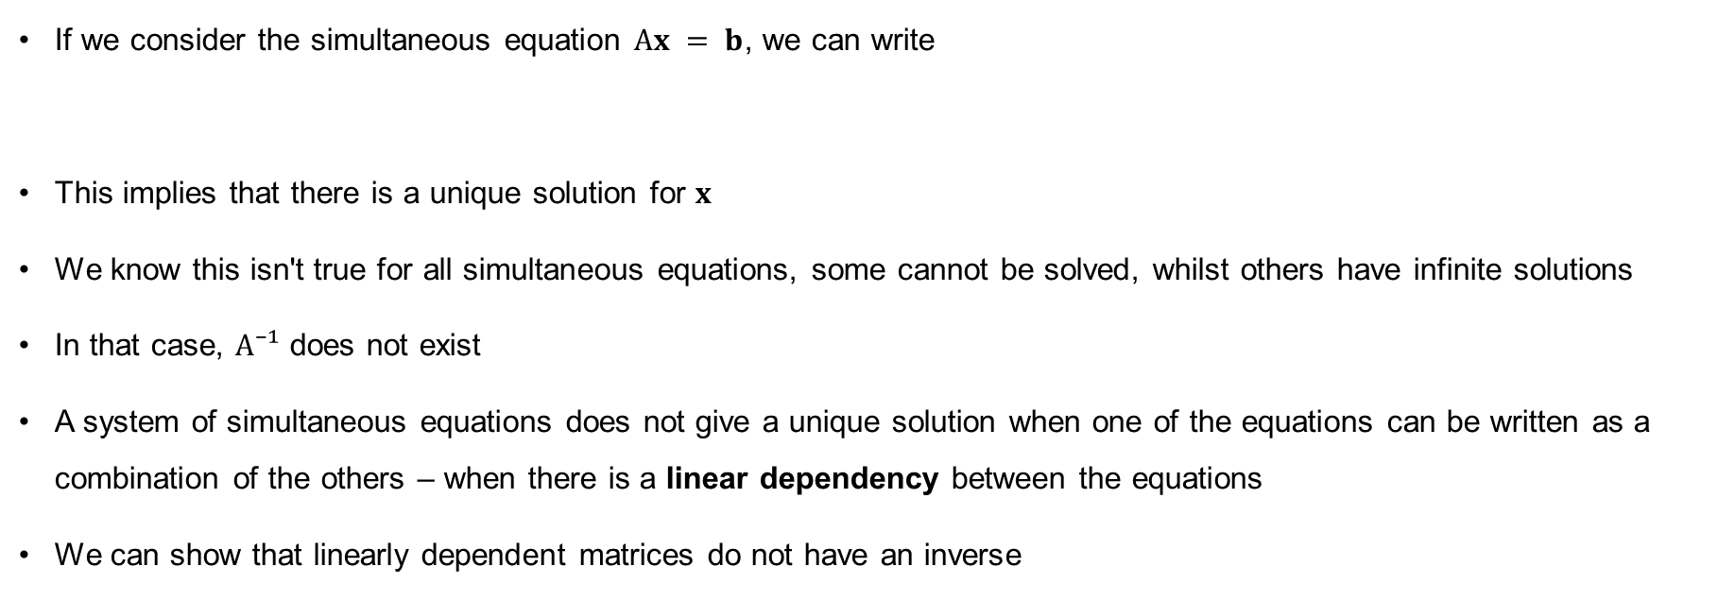
Non-invertible matrices
If we consider the simultaneous equation $Ax = b$, we can write
This implies that there is a unique solution for $x$
We know this isn't true for all simultaneous equations, some cannot be solved, whilst others have infinite solutions
In that case, $A⁻¹$ does not exist
A system of simultaneous equations does not give a unique solution when one of the equations can be written as a combination of the others – when there is a linear dependency between the equations
We can show that linearly dependent matrices do not have an inverse
$$A^{−1}Ax=x=A^{−1}b$$

Slide 34
Non-invertible matrices

Slide 35
Non-invertible matrices

Slide 36
Non-invertible matrices

Slide 37
Non-invertible matrices

Slide 38

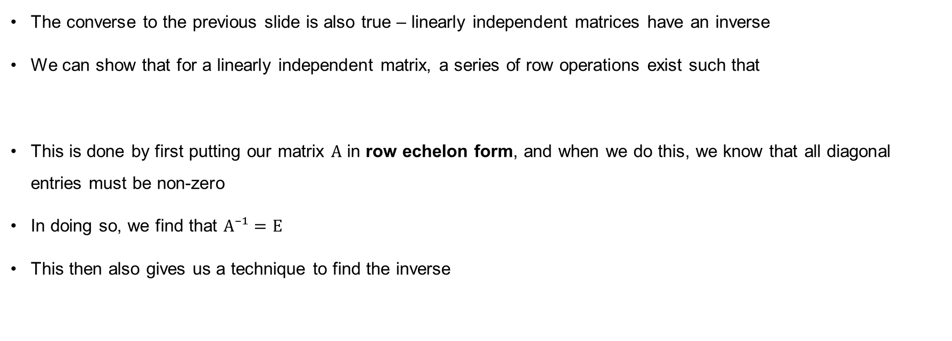
Invertible matrices
The converse to the previous slide is also true – linearly independent matrices have an inverse
We can show that for a linearly independent matrix, a series of row operations exist such that
This is done by first putting our matrix $A$ in row echelon form, and when we do this, we know that all diagonal entries must be non-zero
In doing so, we find that $A⁻¹=E$
This then also gives us a technique to find the inverse
$$EA=I$$

Slide 39
Invertible matrices

Slide 40
Invertible matrices

Slide 41
Invertible matrices

Slide 42
Invertible matrices

Slide 43
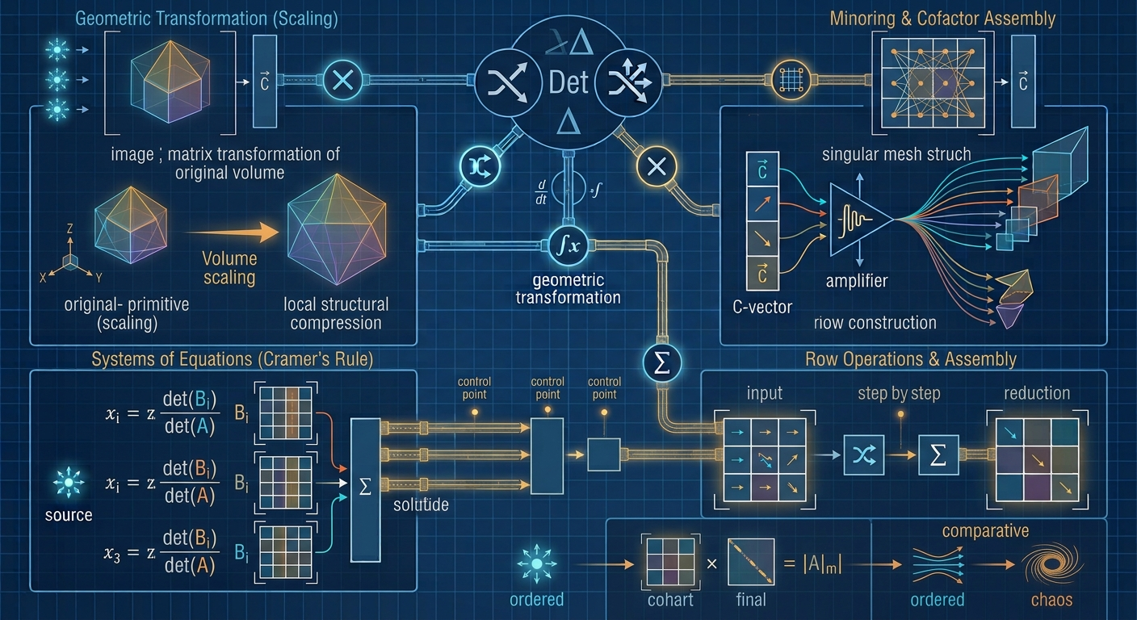
The determinant

Slide 44
Determinants of diagonal matrices
The determinant itself is not too tricky to calculate, at least when we have a matrix that is just numbers (and we don’t make typos)
Scientific computing, however, often requires determinants of algebraic matrices, and additionally, may need to simplify the algebraic expression such that we understand physical or mathematical properties of our system
If we are lucky enough to have a diagonal matrix, or an upper or lower triangular matrix, then the determinant is straightforward to compute – simply multiply the diagonal entries together, and generally easier to simplify
We know we can convert a matrix to row echelon form, and from that, the determinant is now easy to compute, but in using a series of row operations, we might not recover the determinant of the original matrix
All we need to know is what effect the elementary operations we used to obtain row echelon form have on the determinant
Fortunately, this is easy to work out

Slide 45

Effect of elementary operations on determinants
Multiplying a row by a scalar multiplies the determinant by the same scalar
$$A^{′}=E_{λ}A ⟹ det⁡(A^{′})=λ \det\left(A\right)$$

Slide 46
Determinant row multiplication

Slide 47

Effect of elementary operations on determinants
Multiplying a row by a scalar multiplies the determinant by the same scalar
Adding a multiple of one row to another doesn't change the determinant
$$A^{′}=E_{λ}A ⟹ det⁡(A^{′})=λ \det\left(A\right)$$
$$B^{′}=E_{μ}B⟹det⁡(B^{′})=det⁡(B)$$

Slide 48
Determinant row multiple

Slide 49
Determinant row multiple

Slide 50
Effect of elementary operations on determinants
Multiplying a row by a scalar multiplies the determinant by the same scalar
Adding a multiple of one row to another doesn't change the determinant
Switching two rows switches the sign of the determinant
$$A^{′}=E_{λ}A ⟹ det⁡(A^{′})=λ \det\left(A\right)$$
$$B^{′}=E_{μ}B⟹det⁡(B^{′})=det⁡(B)$$
$$C^{′}=E_{ν}A⟹det⁡(C^{′})=−det⁡(C)$$

Slide 51
Determinant row switch

Slide 52
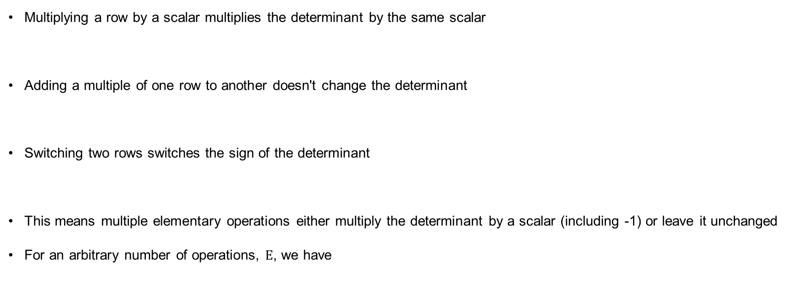

Effect of elementary operations on determinants
Multiplying a row by a scalar multiplies the determinant by the same scalar
Adding a multiple of one row to another doesn't change the determinant
Switching two rows switches the sign of the determinant
This means multiple elementary operations either multiply the determinant by a scalar (including -1) or leave it unchanged
For an arbitrary number of operations, $E$, we have
$$A^{′}=E_{λ}A ⟹ det⁡(A^{′})=λ \det\left(A\right)$$
$$B^{′}=E_{μ}B⟹det⁡(B^{′})=det⁡(B)$$
$$C^{′}=E_{ν}A⟹det⁡(C^{′})=−det⁡(C)$$
$$A^{′}=EA⟹det⁡(A^{′})=α det⁡(A)$$

Slide 53

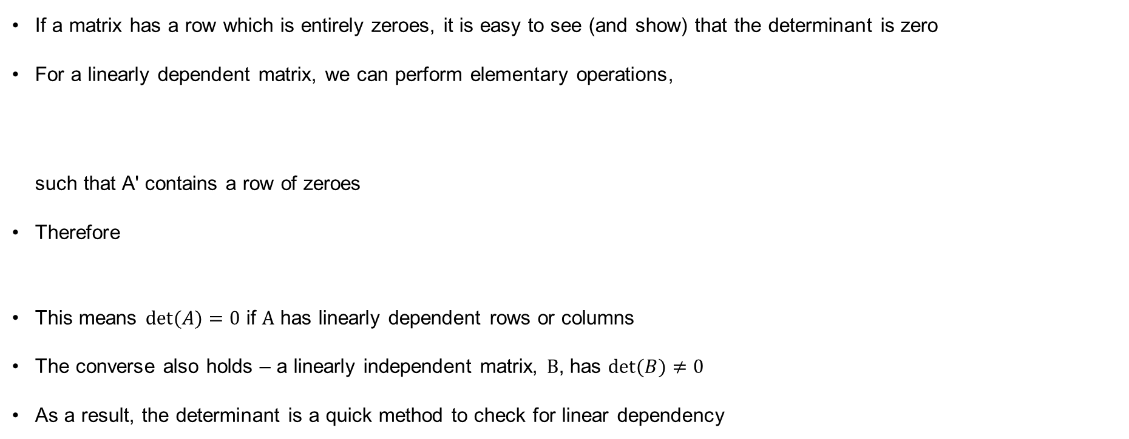
Determinants and linear dependency
If a matrix has a row which is entirely zeroes, it is easy to see (and show) that the determinant is zero
For a linearly dependent matrix, we can perform elementary operations,
such that A' contains a row of zeroes
Therefore
This means $det⁡(A)=0$ if $A$ has linearly dependent rows or columns
The converse also holds – a linearly independent matrix, $B$, has $det⁡(B)≠0$
As a result, the determinant is a quick method to check for linear dependency
$$A^{′}=EA$$
$$det⁡(A^{′})=0 and det⁡(A^{′})=α det⁡(A)$$

Slide 54
Determinants and linear dependency

Slide 55

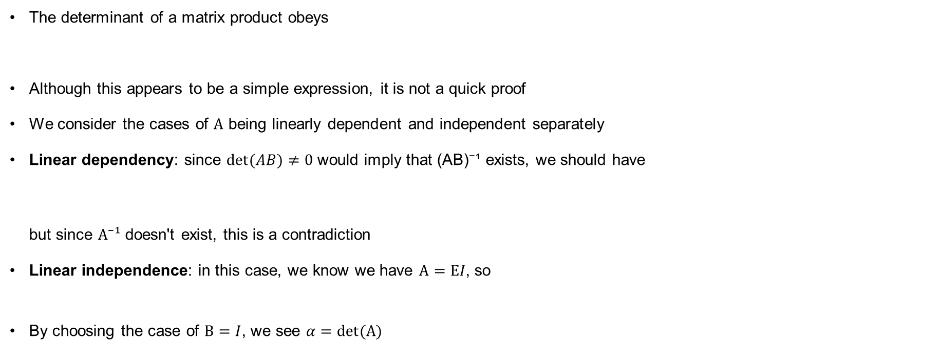


Determinant of a product
The determinant of a matrix product obeys
Although this appears to be a simple expression, it is not a quick proof
We consider the cases of $A$ being linearly dependent and independent separately
Linear dependency: since $det⁡(AB)≠0$ would imply that (AB)⁻¹ exists, we should have
but since $A⁻¹$ doesn't exist, this is a contradiction
Linear independence: in this case, we know we have $A=EI$, so
By choosing the case of $B=I$, we see $α=det⁡(A)$
$$det⁡(AB)=det⁡(A) det⁡(B)$$
$$(AB)(AB)^{−1}=ABB^{−1}A^{−1}=I$$
$$det⁡(AB)=det⁡(EB)=α det⁡(B)$$

Slide 56
Determinant product

Slide 57
Determinant product

Slide 58
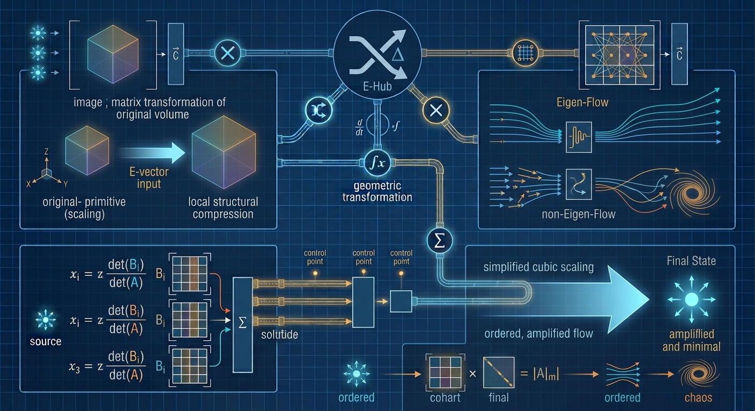
Eigenvalues and eigenvectors

Slide 59
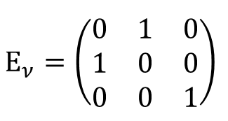
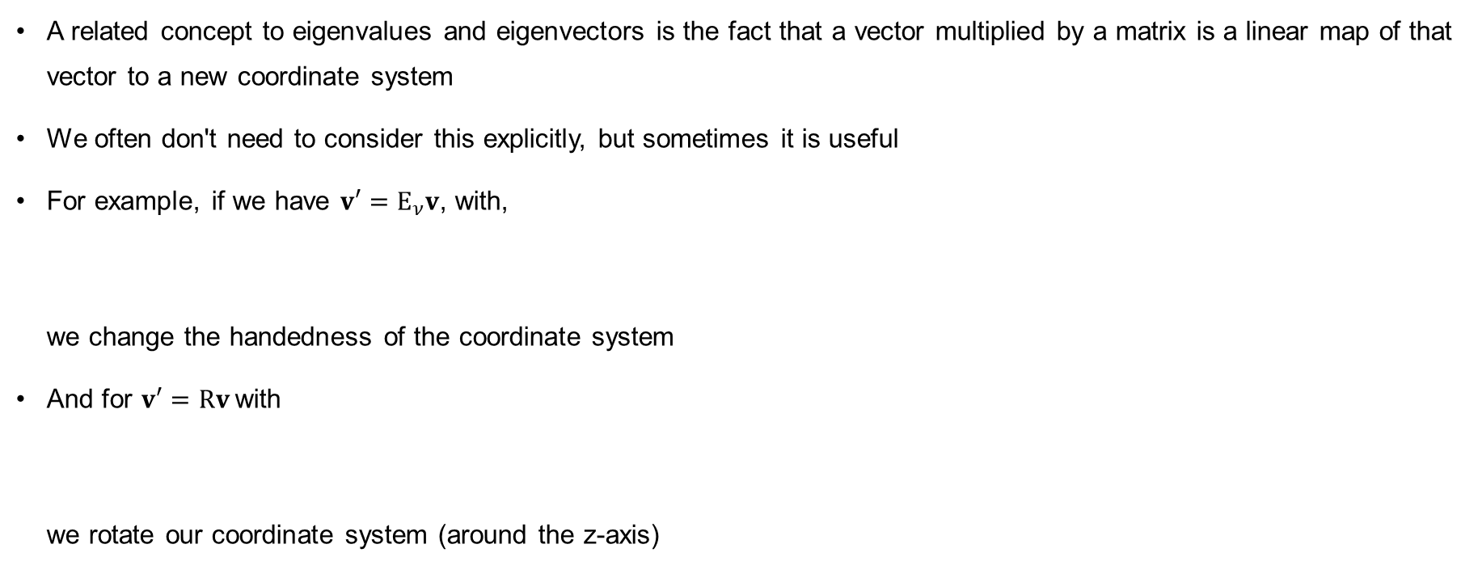
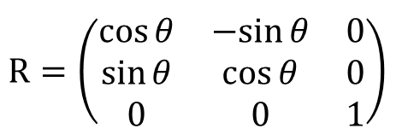
Matrices as coordinate transformations
A related concept to eigenvalues and eigenvectors is the fact that a vector multiplied by a matrix is a linear map of that vector to a new coordinate system
We often don't need to consider this explicitly, but sometimes it is useful
For example, if we have $v′=E_{ν}v$, with,
we change the handedness of the coordinate system
And for $v′=Rv$with
we rotate our coordinate system (around the z-axis)
$$E_{ν}=\left(\begin{matrix}0 & 1 & 0 \\ 1 & 0 & 0 \\ 0 & 0 & 1\end{matrix}\right)$$
$$R=\left(\begin{matrix}cos⁡θ & −sin⁡θ & 0 \\ sin⁡θ & cos⁡θ & 0 \\ 0 & 0 & 1\end{matrix}\right)$$

Slide 60
Matrices as coordinate systems

Slide 61
Rotation matrix

Slide 62

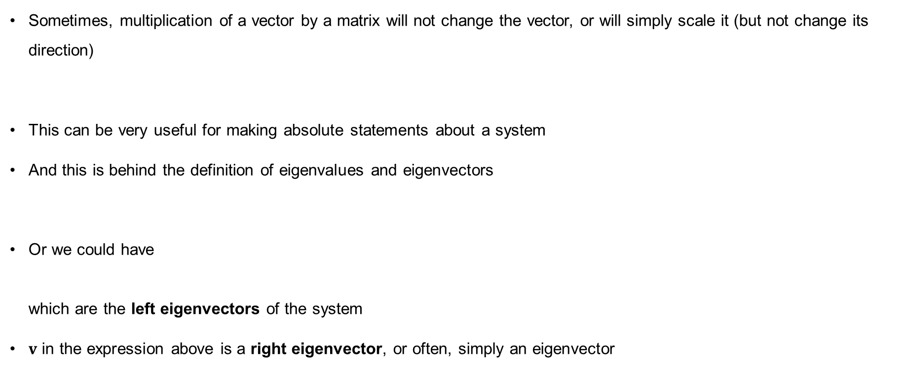
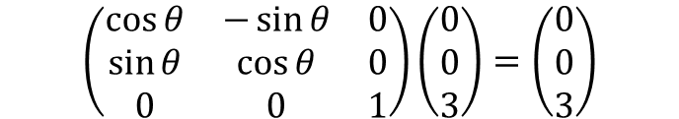

Eigenvalues and eigenvectors
Sometimes, multiplication of a vector by a matrix will not change the vector, or will simply scale it (but not change its direction)
This can be very useful for making absolute statements about a system
And this is behind the definition of eigenvalues and eigenvectors
Or we could have
which are the left eigenvectors of the system
$v$ in the expression above is a right eigenvector, or often, simply an eigenvector
$$\left(\begin{matrix}\cos{θ} & −\sin{θ} & 0 \\ \sin{θ} & \cos{θ} & 0 \\ 0 & 0 & 1\end{matrix}\right)\left(\begin{matrix}0 \\ 0 \\ 3\end{matrix}\right)=\left(\begin{matrix}0 \\ 0 \\ 3\end{matrix}\right)$$
$$Av=λv$$
$$w^{T}A=λw^{T}$$

Slide 63
Relationship between eigenvectors

Slide 64

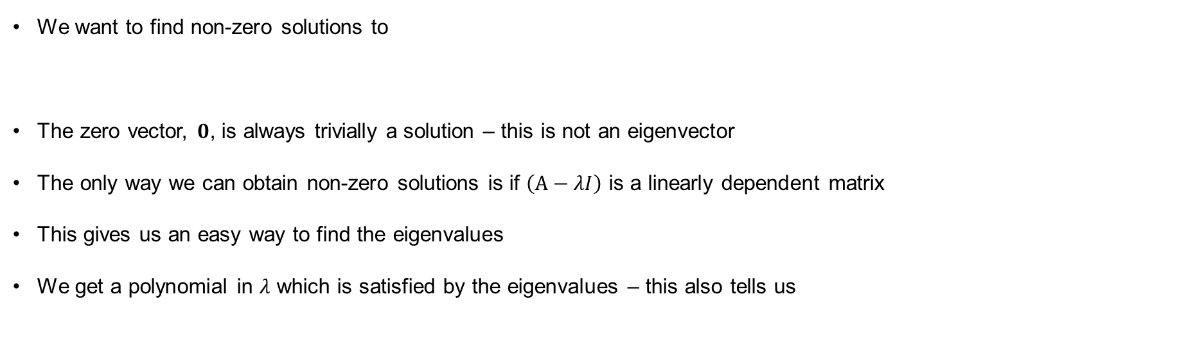



Finding eigenvalues
$$Av=λv$$
We want to find non-zero solutions to
The zero vector, $0$, is always trivially a solution – this is not an eigenvector
The only way we can obtain non-zero solutions is if $\left(A−λI\right)$ is a linearly dependent matrix
This gives us an easy way to find the eigenvalues
We get a polynomial in $λ$ which is satisfied by the eigenvalues – this also tells us
$$(A−λI)v=0$$
$$det⁡(A−λI)=0$$
$$det⁡(A)=λ_{1}λ_{2}λ_{3}⋯λ_{N}$$

Slide 65
Characteristic polynomial

Slide 66
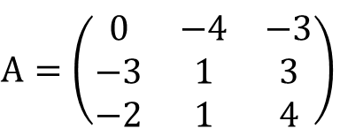
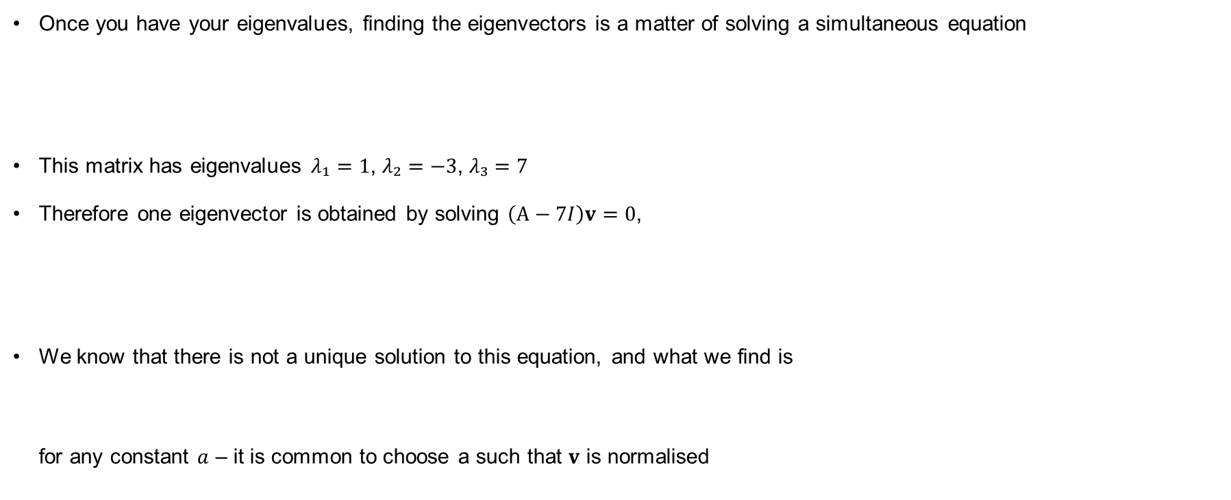
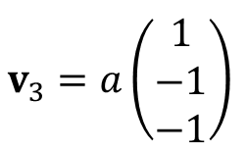
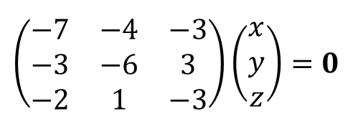
Finding eigenvectors
Once you have your eigenvalues, finding the eigenvectors is a matter of solving a simultaneous equation
This matrix has eigenvalues $λ₁=1$, $λ₂=−3$, $λ₃=7$
Therefore one eigenvector is obtained by solving $\left(A−7I\right)v=0$,
We know that there is not a unique solution to this equation, and what we find is
for any constant $a$ – it is common to choose a such that $v$ is normalised
$$A=\left(\begin{matrix}0 & −4 & −3 \\ −3 & 1 & 3 \\ −2 & 1 & 4\end{matrix}\right)$$
$$\left(\begin{matrix}−7 & −4 & −3 \\ −3 & −6 & 3 \\ −2 & 1 & −3\end{matrix}\right)\left(\begin{matrix}x \\ y \\ z\end{matrix}\right)=0$$
$$v_{3}=a\left(\begin{matrix}1 \\ −1 \\ −1\end{matrix}\right)$$

Slide 67
Unique eigenvalues

Slide 68
Unique eigenvalues

Slide 69
Finding eigenvalues – other possibilities
Our first example considered three unique real eigenvalues
There is no need for them to be either of these – complex eigenvalues are common, and result in complex eigenvectors, and repeated eigenvalues are common too (see next slide)
The eigenvalues of diagonal and triangular matrices are particularly easy – they are the diagonal entries
Elementary row operations do not change the eigenvalues of a matrix – this means you can sometimes manipulate a matrix to make finding the eigenvalues easier
Linearly dependent matrices always have at least one eigenvalue of zero

Slide 70
Unique eigenvalues, diagonal matrices

Slide 71
Triangular matrices and linear dependent

Slide 72
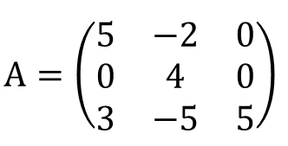
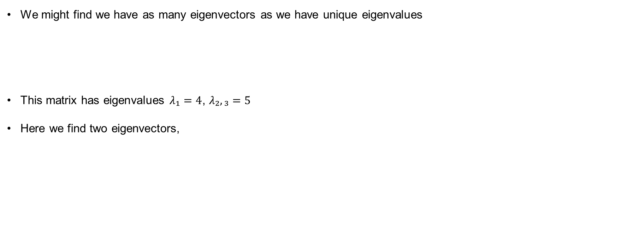
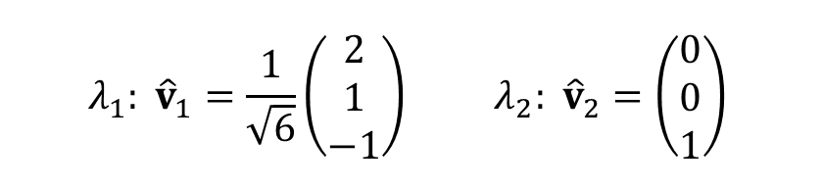
Finding eigenvectors – repeated eigenvalues
We might find we have as many eigenvectors as we have unique eigenvalues
This matrix has eigenvalues $λ₁=4$, $λ₂,₃=5$
Here we find two eigenvectors,
$$A=\left(\begin{matrix}5 & −2 & 0 \\ 0 & 4 & 0 \\ 3 & −5 & 5\end{matrix}\right)$$
$$λ_{1}: {\hat{v}}_{1}=\frac{1}{\sqrt{6}}\left(\begin{matrix}2 \\ 1 \\ −1\end{matrix}\right) λ_{2}: {\hat{v}}_{2}=\left(\begin{matrix}0 \\ 0 \\ 1\end{matrix}\right)$$

Slide 73
Repeated eigenvalues

Slide 74
Repeated eigenvalues

Slide 75
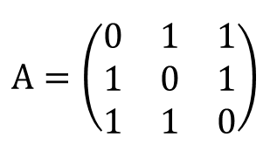



Finding eigenvectors – repeated eigenvalues
We might find we have more eigenvectors than we have unique eigenvalues
This matrix has eigenvalues $λ₁=2$, $λ₂,₃=−1$
Here we could say that we find two eigenvalues,
However, we could split ${\overset{ˆ}{v}}_{2}$ into two vectors (one using $x$, one using $y$):
$$A=\left(\begin{matrix}0 & 1 & 1 \\ 1 & 0 & 1 \\ 1 & 1 & 0\end{matrix}\right)$$
$$λ_{1}: {\hat{v}}_{1}=\frac{1}{\sqrt{3}}\left(\begin{matrix}1 \\ 1 \\ 1\end{matrix}\right) λ_{2}: {\hat{v}}_{2}=\left(\begin{matrix}x \\ y \\ −x−y\end{matrix}\right)$$
$${\hat{v}}_{2}=\frac{1}{\sqrt{2}}\left(\begin{matrix}1 \\ 0 \\ −1\end{matrix}\right), {\hat{v}}_{3}=\frac{1}{\sqrt{2}}\left(\begin{matrix}0 \\ 1 \\ −1\end{matrix}\right)$$

Slide 76
Repeated eigenvalues part 2

Slide 77
Repeated eigenvalues part 2

Slide 78
Identity matrix eigenvalues

Slide 79
Linear independence of eigenvectors
Whilst it is clear that all the eigenvectors we have found so far are different, this doesn't necessarily mean they are linearly independent
However, it is possible to show that they are – the eigenvectors from distinct eigenvalues are always linearly independent
For cases where repeated eigenvalues can be written as more than one eigenvector, we can also choose these to be linearly independent
A result of this is that two eigenvalues can never have the same eigenvector
In fields where eigenvectors form a useful coordinate system, knowing that they are independent is particularly important

Slide 80
Linear independence of eigenvalues

Slide 81
Linear independence of eigenvalues

Slide 82



Diagonalisation
Once we have identified the eigenvalues of a matrix, we know that a diagonal matrix, with these eigenvalues as the entries, would clearly have the same eigenvalues
This means there is a technique, diagonalisation which allows you to connect these two matrices
Specifically, we have
where $S$ is the matrix whose columns are the eigenvectors of $A$
Not all matrices are diagonalisable, e.g. an $N×N$ matrix without $N$ eigenvectors
But where a matrix is diagonalisable, this has useful implications, including when computing matrix powers
$$A=SΛS^{−1}$$
$$A^{m}=SΛ^{m}S^{−1}$$

Slide 83
Diagonalisation

Slide 84
Diagonalisation

Slide 85
Diagonalisation

Slide 86
Diagonalisation

Slide 87
Diagonalisation

Slide 88


Similar matrices
The relationship we saw for diagonalisable matrices does generalise – any matrices $A$ and $C$ related by
are similar matrices
Similar matrices have some useful properties:
    They have the same determinant
$$C=BAB^{−1}$$

Slide 89
Similar matrices determinant

Slide 90

Similar matrices
The relationship we saw for diagonalisable matrices does generalise – any matrices $A$ and $C$ related by
are similar matrices
Similar matrices have some useful properties:
    They have the same determinant
    They have the same eigenvalues
$$C=BAB^{−1}$$

Slide 91
Similar matrices eigenvalues

Slide 92

Similar matrices
The relationship we saw for diagonalisable matrices does generalise – any matrices $A$ and $C$ related by
are similar matrices
Similar matrices have some useful properties:
    They have the same determinant
    They have the same eigenvalues
    They have related eigenvectors (but not the same eigenvectors)
When dealing with algebraic matrices in particular, similar matrices can be useful to make it easier to compute some of these properties
$$C=BAB^{−1}$$

Slide 93
Similar matrices eigenvectors

Slide 94

Similar matrices
The relationship we saw for diagonalisable matrices does generalise – any matrices $A$ and $C$ related by
are similar matrices
Similar matrices have some useful properties:
    They have the same determinant
    They have the same eigenvalues
    They have related eigenvectors (but not the same eigenvectors)
$$C=BAB^{−1}$$

Slide 95
Symmetric matrices
It is quite common for physical systems with matrix quantities to have symmetric matrices
These have particularly useful properties which can greatly simplify computations
The eigenvalues of a symmetric matrix are always real – this is very useful to know if you want to compute these computationally
The eigenvectors of a symmetric matrix are always orthogonal – we can sometimes use this to create a coordinate system with useful physical properties

Slide 96
Symmetric matrices

Slide 97
Symmetric matrices

Slide 98

LU decomposition

Slide 99



Triangular matrices in simultaneous equations
We know that we can use various matrix operations to solve simultaneous equations
However, in scientific computing, $A$ could be large – algorithms which work through row reduction operations can be very expensive
Sometimes $A$ has nice properties, however
Here, we can read off the solution for $z$, and use this directly to find $y$, and then use that to find $x$ (and similar for higher dimensions)
Lower triangular matrices have similar nice properties
$$Ax=b$$
$$\left(\begin{matrix}1 & 1 & 1 \\ 0 & 2 & 1 \\ 0 & 0 & 1\end{matrix}\right)\left(\begin{matrix}x \\ y \\ z\end{matrix}\right)=\left(\begin{matrix}1 \\ 1 \\ 2\end{matrix}\right)$$

Slide 100




LU decomposition
For any matrix, we can perform elementary operations to obtain,
where $U$ is an upper-triangular matrix
Now, if none of the elementary operations were row-switching operations, then we have,
a lower-triangular matrix
This is the LU decomposition, we can write
Solving the simultaneous equations is now straightforward
$$A=EU$$
$$E=L$$
$$A=LU$$

Slide 101
LU decomposition

Slide 102
LU decomposition

Slide 103
LU decomposition

Slide 104



Using LU decomposition
From $Ax=b$ we have;
Now set $y=Ux$,
This is a lower-triangular simultaneous equation, it is easy to solve for $y$
But now, $y=Ux$ is an upper-triangular simultaneous equation with known $y$ – this is also easy to solve
So, provided L and U were constructed with the right properties, instead of row-reductions on $A$ directly, we did row reductions on $A$ to get $U$ (and $L$ at the same time), then use this to solve the equation
For a single equation, this hasn't gained us a lot, keeping track of two matrices is definitely harder than row-reducing one, but…
$$LUx=b$$
$$Ly=b$$

Slide 105

Applications of LU decomposition
It is common to need to solve $Ax=b$ repeatedly for different values of $x$ but a single $A$
Or, maybe more accurately, for a matrix $A$ which has algebraic entries, so performing the LU decomposition once is time-consuming, but then each time it is used, you just plug in numbers directly into the lower- and upper-triangular matrices
LU decomposition means we only perform the complex elementary operations once, rather than for every equation – a large computational saving
However, we said that we must avoid row switching for this to work; the chance our elementary operations avoid row switching is quite small
In that case, we first work out what switches are needed to obtain U, perform these on the system before decomposing, and then compute L and U for the newly ordered system – again, this could be time consuming, but it only needs doing once

